Slide 1
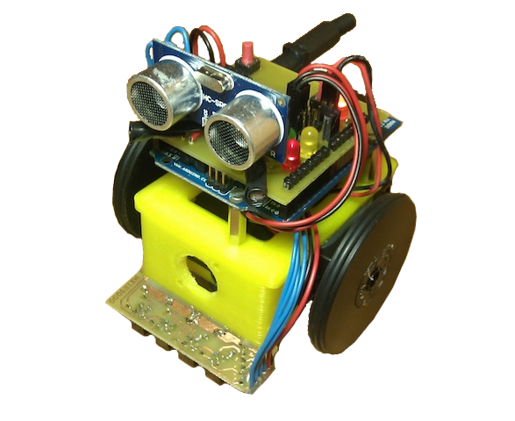
Lesson 1 - Introduction
ArduSkyBot 2012 Summer Workshop
Today you will learn:
Basic components of a robot.
What is Arduino and how to program it.
Meet the ArduSkyBot!
You will play music and make LED's blink!
Organized by: Carlos García Saura
July-August 2012

Slide 2
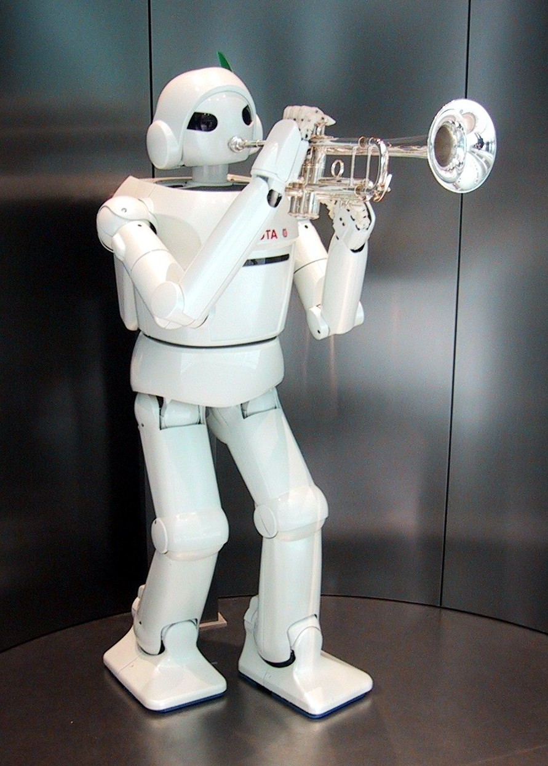
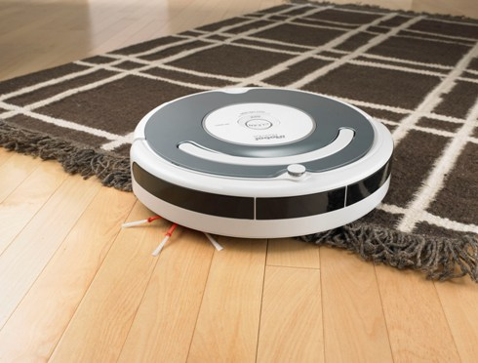
What is a robot?
Autonomous device
that is able to make pre-programmed tasks

Slide 3
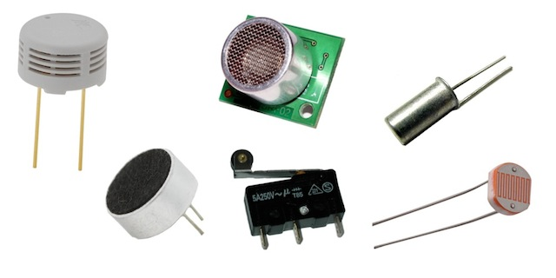
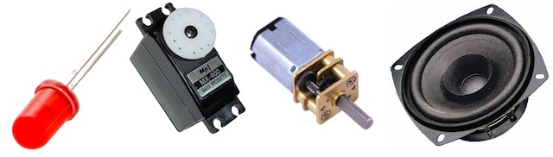
Components of a robot
Sensors
Actuators

Slide 4
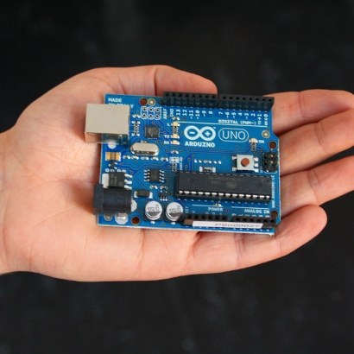
Arduino
Open source
electronics platform
It is the “brain”
of our robot!
You can program it with a computer

Slide 5
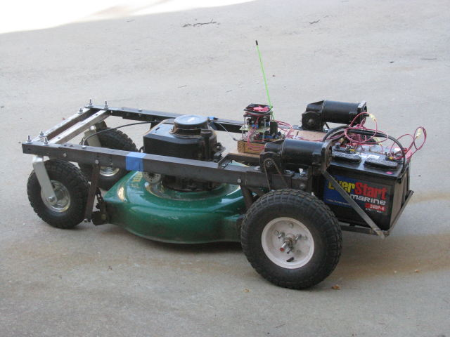
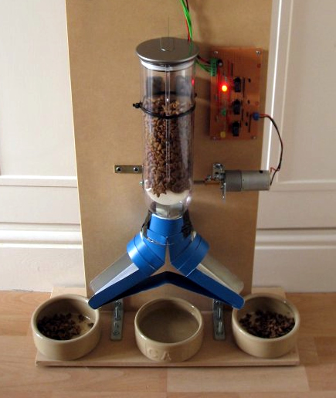
Arduino (2)
People make crazy projects
RC lawnmower!
Automatic toilet flush:
http://www.youtube.com/watch?v=4k899QWsJwI
Arduino paper cat:
http://www.youtube.com/watch?v=ZzZ4_g4YzxY
Automatic feeder

Slide 6
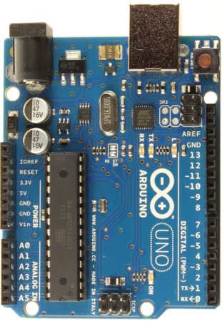
Arduino (3)
We are using Arduino UNO
It has lots of input/output pins
You can connect any kind of sensors and actuators

Slide 7
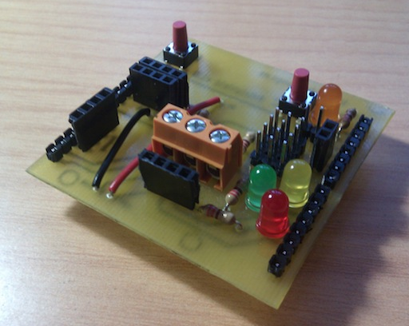
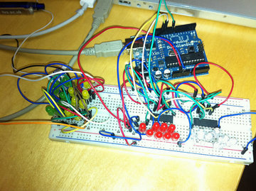
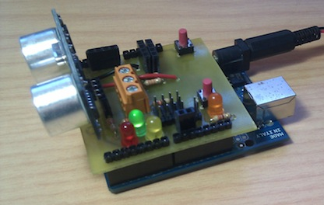
Arduino & Printshield
Compact electronics using an Arduino UNO with a Printshield

Slide 8
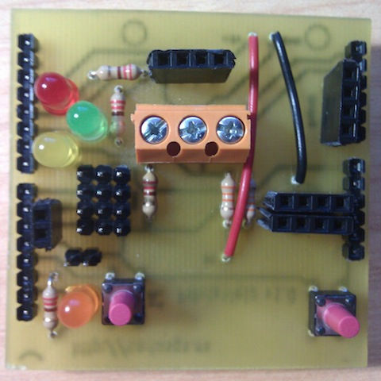
Printshield
Connector
for light sensors
Connector for
distance sensor
LED lights
Connector for
line sensor
Connectors
for servo-motors
-
+
5V Power line
Another
LED light
Speaker
connector
Restart/reset
button
Push button

Slide 9
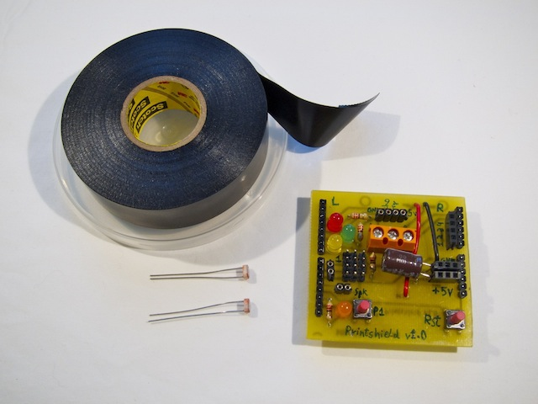
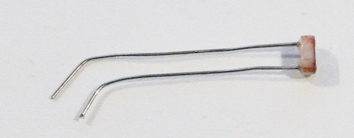
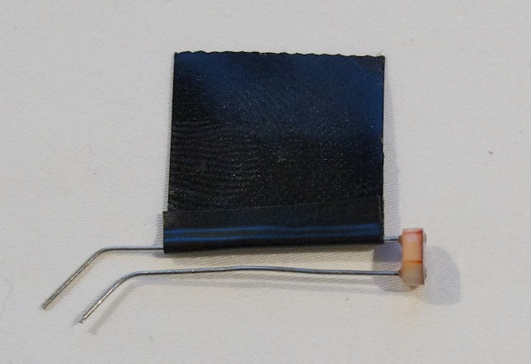
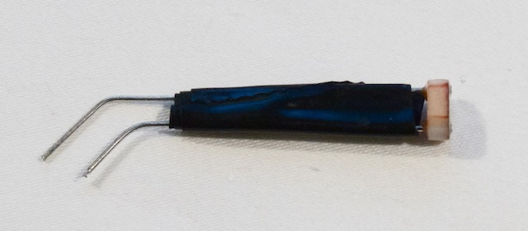
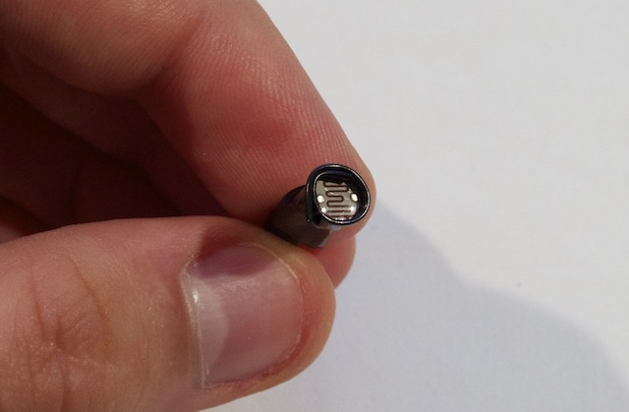
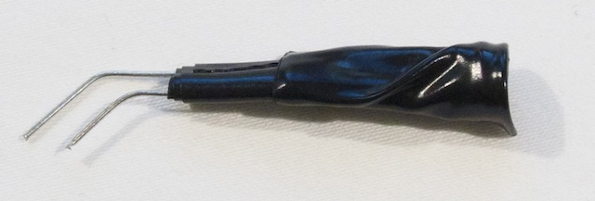
Assembling the Printshield (1)
First we need to insulate the
light sensors with black tape

Slide 10
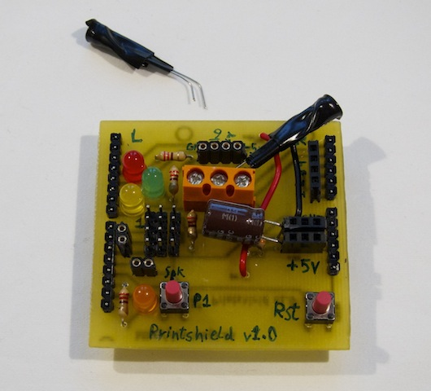
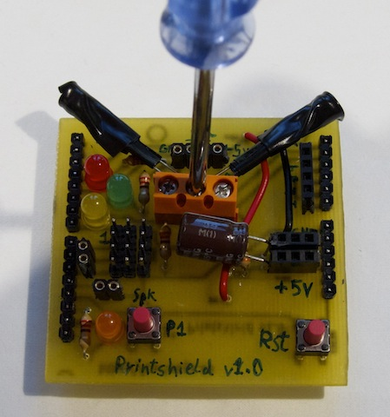
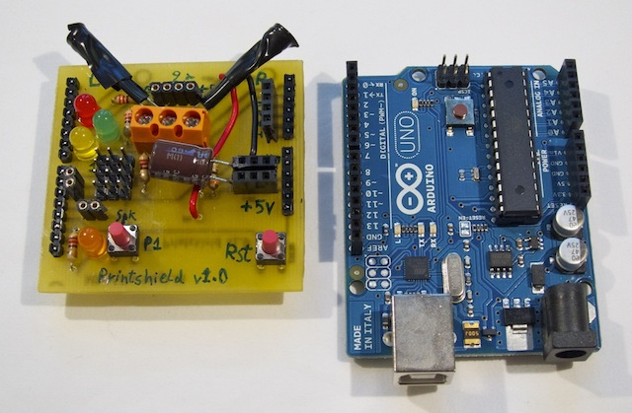
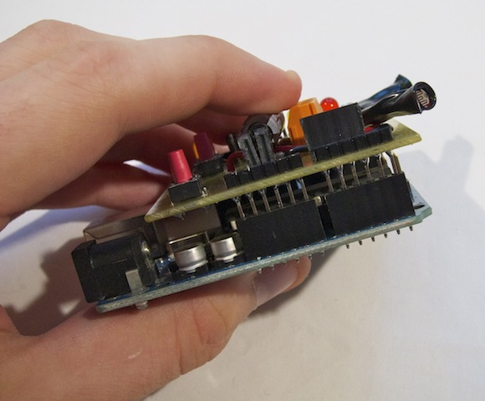
Assembling the Printshield (2)
Light sensors need to be screwed
into the orange connector
Then we must plug the Printshield
on the Arduino UNO board

Slide 11
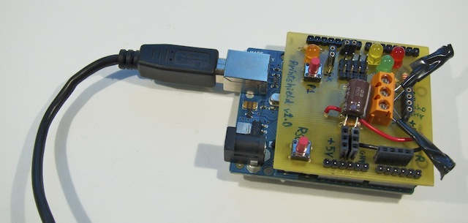
Plug it into the computer!
Speaker plugs here
USB cable
Now we just need to load our programs into the board.

Slide 12
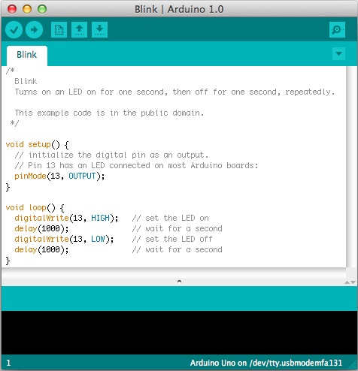
Load the “Blink” example
Download more example code from
http://www.carlosgs.es/2012-summer-workshop

Slide 13
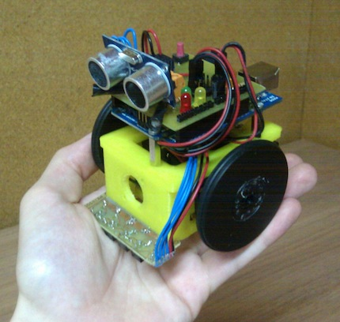
Say hello to the ArduSkyBot!
It features:
Push buttons
Frontal distance sensor
Two light sensors
Lots of LED lights
Line sensor

Slide 14

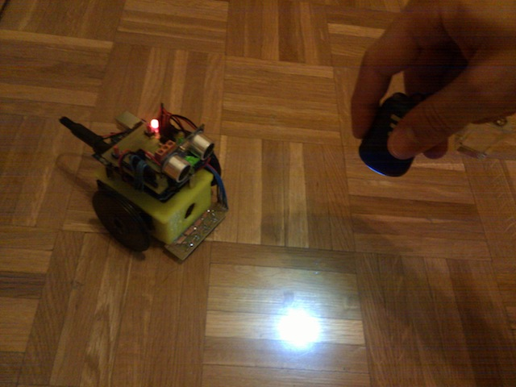
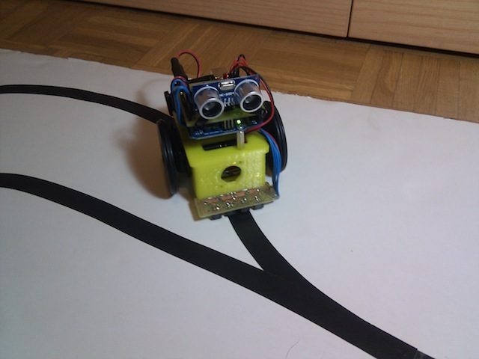
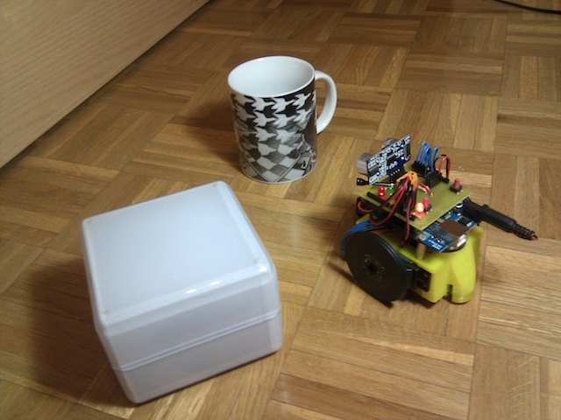
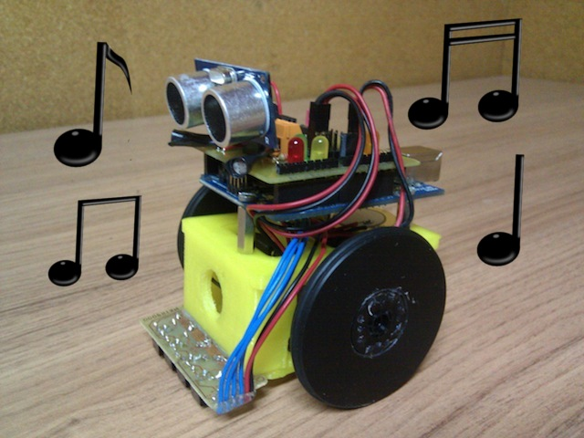
What can the ArduSkyBot do?
Some examples:
Follow light
Line follower
Avoid obstacles
Play music tones

Slide 15
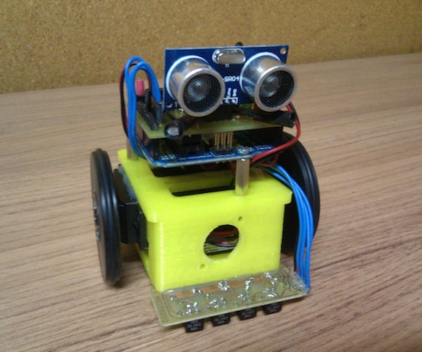
Tomorrow more!

Slide 16

License
This work is licensed under the
Attribution - Share Alike
Creative Commons license.
http://creativecommons.org/licenses/by-sa/3.0/
Author:
Carlos García Saura

